Slide 1
Creatieve makers [cm³]
What?
An initiative from KULeuven and LUCA | School of Arts
Inter-disciplinary curriculum for engineers, architects and artists.
How?
- Elective/summerschool, workshops, makerspace, VR/AR/XR lab

Slide 2
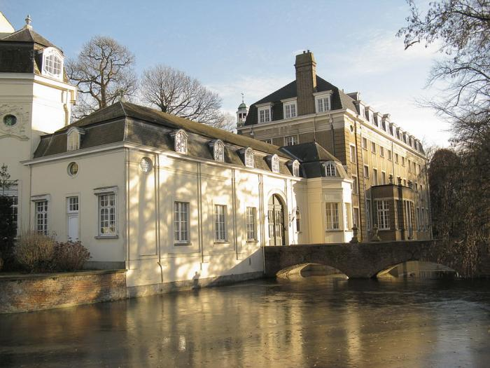
Summerschool: Sense adapt create
September 5th-15th
Castle “Ter Beken” Mariakerke
6 study points

Slide 3
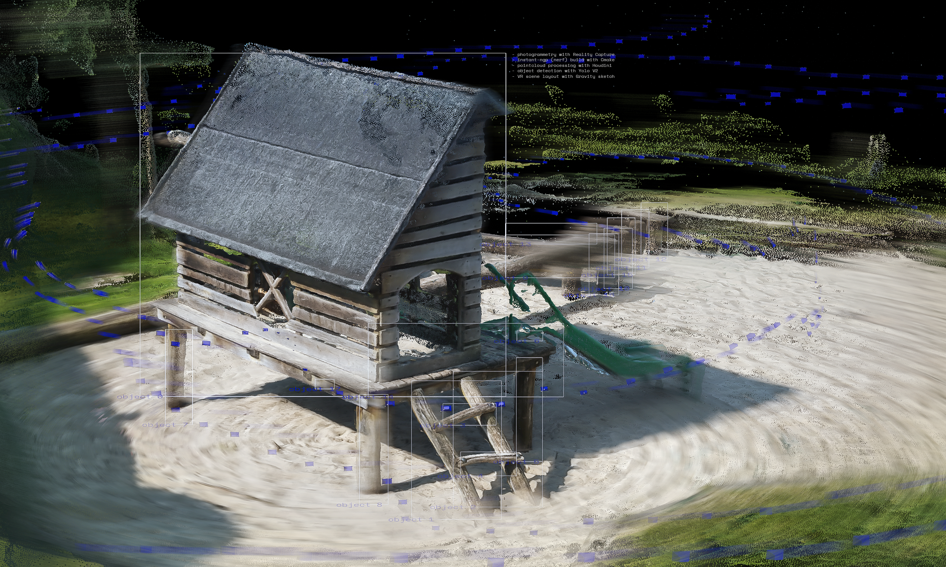

Slide 4
Sense
Building/using sensors that:
Capture the invisible layer (wifi, bluetooth, sound, etc)
Capture geometric data
(pointclouds, lidar,
photogrammetry, odometry, )

Slide 5
Adapt
- Data processing /reconstruction
(drawing, programming, modeling,
rendering, simulating, 3dprinting,
visualising, building machine learning models, etc)

Slide 6
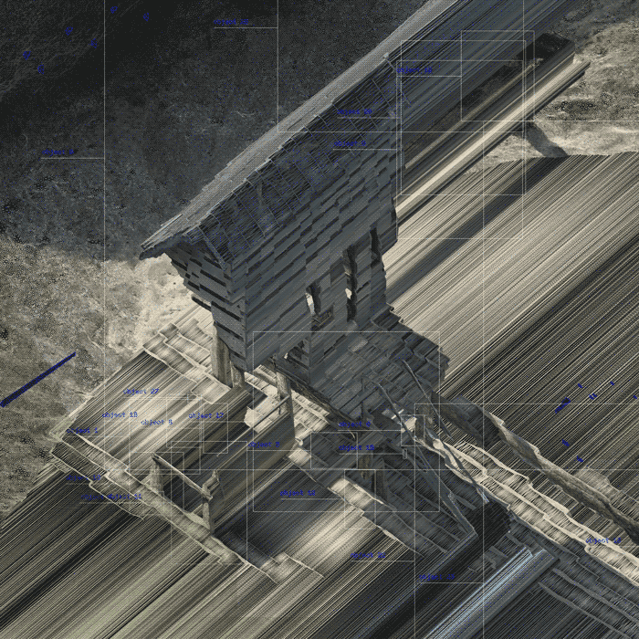
Create
Representational methods (AR/VR, XR, game, physical prototype, video, installation, real time etc..)
Iterative and Non-lineair process
Notes:
µ

Slide 7
Team
dr. Gilles Callebaut , dr. Corneel Cannaerts, drs. Weronika Gajda, dr. Liselotte Vroman , Joris Putteneers, Kasper Jordaens
When?
September 5th-15th
Where?
Kasteel “Ter Beken”, Mariakerke;
Campus Sint-Lucas and Ghent Technology Campus. Accomodation for participants is provided during the period of the Summer School.

Slide 8
who?
3th Bachelors or Master students in the fields of Architecture, Urban Design, Arts and Engineering.
6 study points ( 3 summerschool & 3 in the 1st sem)
Deadline for application:
June 6th 2022
Interested candidates should send their CV, a motivation letter (maximum 300 words in English), including a link to a portfolio (if relevant) to: summerschool@creativemakers.xyz
Confirmation of acceptance: June 27th 2022

